Slide 1
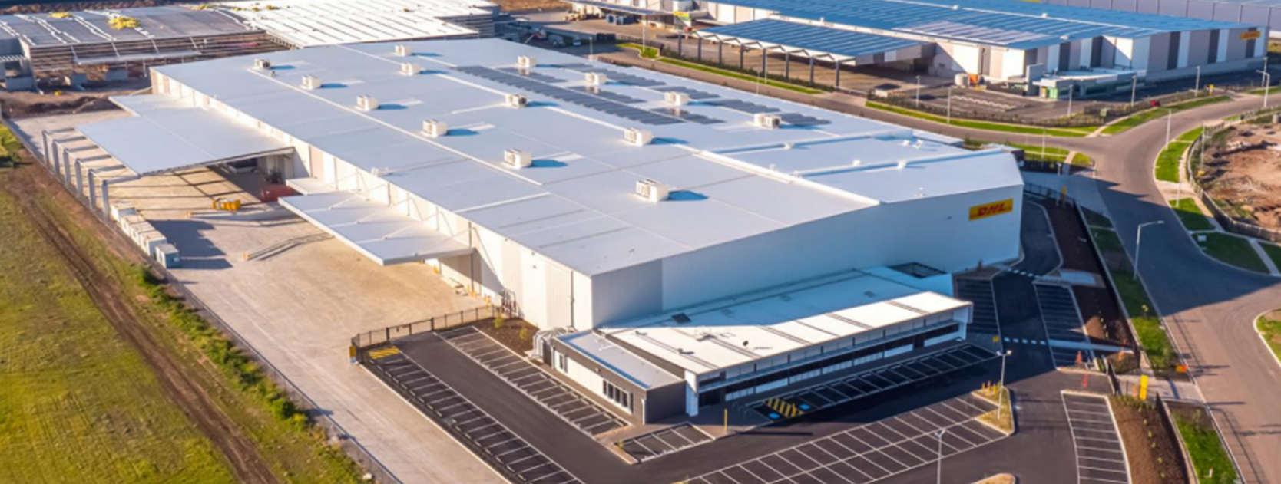
Thailand Logistics Strategy
2023 | Presenter Name | Client Name

Slide 2
Contents
1
APAC Logistics Overview
2
Thailand Country Overview
3
Project Scale Overview
4
Potential Initial Land Pipeline
5
Investment Strategy

Slide 3
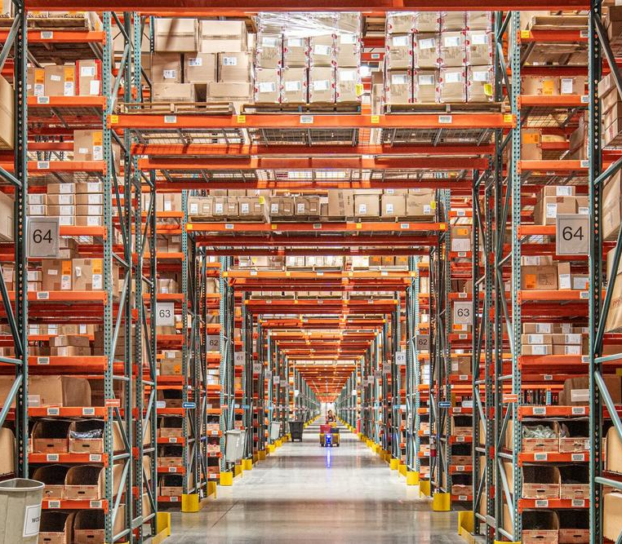
APAC Logistics Overview
1

Slide 4
















APAC Logistics: Attractive Sector that SIM can Credibly Exploit
15-17%+* net IRR
7-9%+* yield on cost
8-10%+* net IRR
4%+* NOI yield
Early mover advantage in emerging markets
Diversified APAC logistics fund to fulfil product gap in market
TH
VN
ID
MY
KR
JP
AU
HK
TH
VN
ID
MY
We think built-to-suit and development opportunities are attractive in emerging APAC…
…and developed Asia presents defensive, recurrent income opportunities
Local, boots-on-the-ground team:
Ability to source off-market +
Strong tenant relationships
Currently no market product dedicated to diversified APAC logistics
Robust population & consumption growth
Undersupplied modern logistics space
Leverage Samsung relationship to generate accretive returns
Core to strategy
Favourable demand megatrends
Structural undersupply exacerbated in APAC
Augment off-market sourcing
Global strategic tentpole but currently no stated strategy in APAC and no business of any substance
* For indicative purposes only; there is no guarantee that any particular return or distribution will be realized.

Slide 5














APAC Logistics: Strong Fundamentals
APAC Logistics Drivers
Market Gaps
Market Type
Strategy
Markets
Developed markets with deep liquidity
Significant component of ageing stock
Selective build to core
JP
AU
Value-add of ageing stock
Lack of modern logistics stock
Rise of middle class
Explosion in digital payments
KR
HK
Developing markets with limited existing stock but strong growth factors
TH
VN
Build to core / Build to suit
Growth in online sales
Infrastructure connectivity improving
Strong growth aspirations by potential tenants
ID
MY
Structural drivers of logistics are strong
Markets gaps present clear opportunities
Heterogenous conditions in Developed and Developing APAC
Strong ESG framework to ensure all assets are compliant and future-proofed
Different markets different strokes
Source: Savills Investment Management, Jul 2023

Slide 6
Middle Class Growth Is An APAC Story (Key Growth Driver)
The middle-class population in Asia-Pacific is expected to increase from 1.38 billion people in 2015 to 3.49 billion people in 2030
Forecast of Global Middle-Class Population (Million)
Post-Growth Markets
Sub-Scale Markets
Source: Brookings Institution, 2017

Slide 7



But Logistics Markets In Different Phases Of Maturity
Phase 1: Nascent
Phase 2: Exponential growth and value creation
Phase 3: Mature and liquid
Logistics costs fall towards international levels
Demand for modern logistics increases
Online retail starts
Mobile payments become prevalent
Fast-Moving Consumer Goods industry emerges
Infrastructure development becomes a priority
Credit card payment becomes mainstream
Local operators adopt best practices and expand presence
Greater legislation, which is supportive of institutional participants
Source: Savills Investment Management, Jul 2023

Slide 8
…Driving E-commerce Growth
E-commerce expenditure is expected to increase in parallel with that of mobile payments, which is a massive boost towards regional demand for logistics real estate
E-commerce market value growth (CAGR, 2020-2025)
Source: Statista Digital Market Outlook, 2021

Slide 9
Market Penetration Is Still Low
Estimated Logistics Space Per Capita (Sqm Per Capita)
Thai Market Needs To Grow 17x to Match US
Source(s): Mapletree Logistics Trust, Prologis, Mandiri Sekuritas, Savills IM estimates, 2022
Note(s): Data is based on estimates from various sources

Slide 10
Emerging APAC – Lowest Penetration and Allocation by our Competitors
29%
CN
12%
KR
$15.9b
$6.8b
6%
HK
12%
$3.4b
JP
Emerging
APAC
$6.7b
9%
~$5b
26%
6%
AU
SG
$14.1b
$3.1b
 |  | Target Developed APAC Markets
 |  | Target Emerging APAC Markets
Source: MSCI Real Capital Analytics, Sep 2021

Slide 11
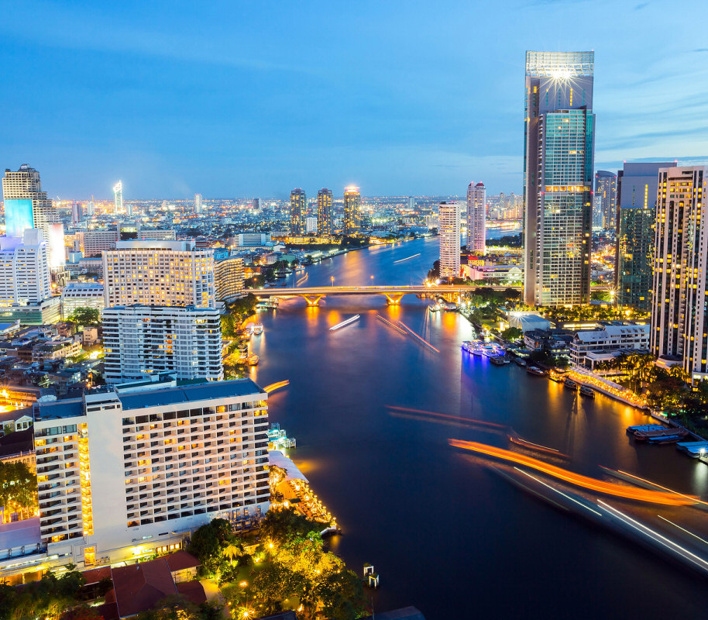
Thailand Country Overview
2

Slide 12


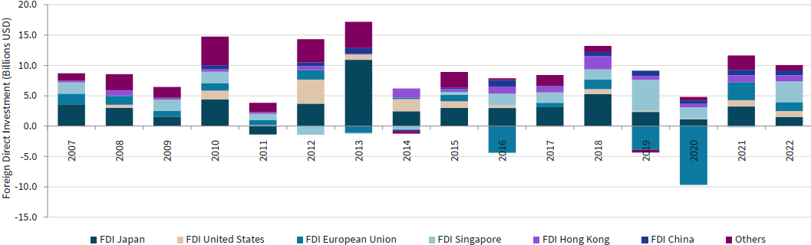




Thailand Country Overview
Total land size
510,890 sqkm
Foreign Direct Investment
Currency
Thai Baht
GDP Growth
4.9% (1Q23)
Population
72 million
GDP per capita
USD7,300 (2023)
Improved its ease of doing business – foreign direct investment applications in Thailand rose 36% in 2022, after the significant 59% hike in 2021
2022 export value clinched a record high of US$287 billion (5.5% growth yoy)
Headline inflation
2.5% (2023 forecast)
Source: Doing Business in Thailand 2022, PwC; The State of Logistics Asia-Pacific Focus Report 2023; Knight Frank, Apr 2023; Thailand logistic & Industrial market overview, JLL 2023; International Monetary Fund, 2023

Slide 13
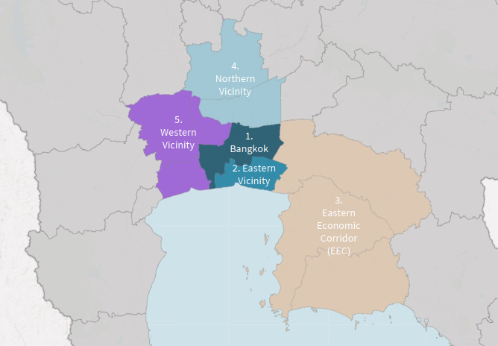
Thailand Logistics Submarket
 | Submarket | Province(s)
1 | Bangkok | Bangkok
2 | Eastern vicinity | Samut Prakan
3 | East Economic Corridor (EEC) | Chachoengsao, Chonburi, Rayong
4 | Northern Vicinity | Pathum Thani, Ayutthaya
5 | Western Vicinity | Samut Sakhon, Nonthaburi, Nakhon Pathom
Source: Thailand logistic & Industrial market overview, JLL 2023

Slide 14
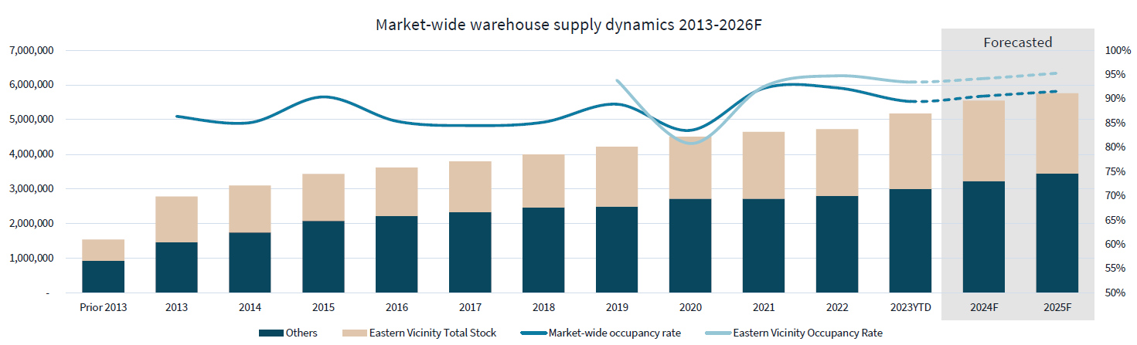
Thailand Logistics - Warehouse Supply and Demand
Since 2020, roughly a fifth of the prime-grade warehouse supply are built-to-suit warehouse with an increasing trend as a result of the market maturity. Tenants seeking built-to-suit facilities with longer lease to achieve better lease term and rental rate
In the recent years key developers such as Frasers Properties and WHA have shifted their focus to built-to-suit approach as a mean to manage investment risk
The slight drop of occupancy in 2020 was a result of the increased supply on the Eastern Vicinity submarket, but they supply was absorbed in the following years to indicate strong performance for the submarket
Source: Thailand logistic & Industrial market overview, JLL 2023

Slide 15
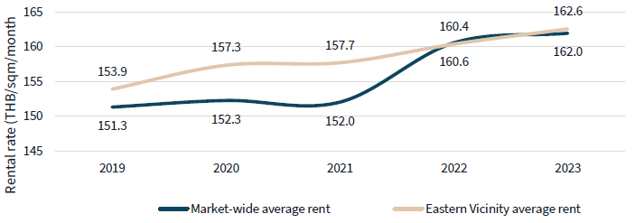
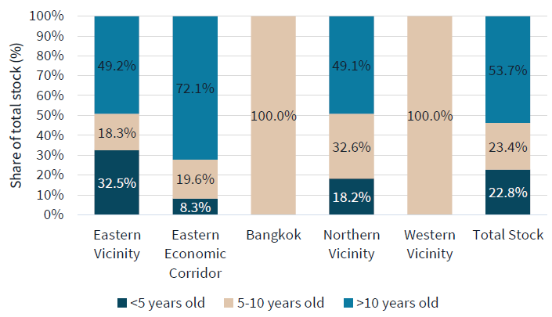
Thailand Logistics – Rent and Warehouse Age
Rent Dynamics 2019 - 2023
Warehouse Age Distribution by Submarket, 2Q2023
The Eastern Vicinity area demands higher rent than the market average due to its location, as it is short commute into Bangkok area, as well as the Suvarnabhumi Airport, and its convenient road connectivity to the manufacturing hub in the Eastern Economic Corridor
In 2018 the share of the market of supply less than 5 years old was at 27.2% whilst in 2023 the share of supply aged less than 5 years is at 32.5%, a clear increase in the market share. Expect in 2023 and 2024 will be the second wave of supply influx with the market share of newer supply set to expand as the market will see more competitive prime grade supply
Source: Thailand logistic & Industrial market overview, JLL 2023

Slide 16
Two-Horse Race + Fragmented Market
3
~26% of logistics market remains fragmented
1
Currently ~74% of logistics market share dominated by Frasers & WHA
Frasers Property
Compelling investment opportunity:
Improve build quality
+
Acquire market share
+
Consolidate
2
Closed-ended ecosystem;
little incentive to improve existing build quality
Attractive
WHA
Group
Sources: Knight Frank, Savills Investment Management, Frasers Property Limited, WHA Corporation PCL, 2022

Slide 17
Opportunity in Thailand’s Logistics Sector
Investment Strategy Logistics development in areas of strong demand in Greater Bangkok. Preferred Pre-commit over +60% of space Leveraging SIM global tenant relationships
Attractive Risk Adjusted Returns 15-17%+ net IRR 7-9% net yield-on-cost
Target Size Up to US$120 million of equity commitment Fund, Club or Joint Venture
Focus on Built-To-Suit in Greater Bangkok The seeds development site comprises a combination of built-to-suit (BTS) assets and speculative development assets Final mix aiming for +65% BTS
SIM Team has development Track Record in Thailand and APAC Global reputation for reliability and institutional risk management Trusted partner for many logistics developers/tenants globally Track record of quality investments at attractive price points
Platform Structure Two-tier ownership structure w/ preferential shares Tax efficient w/ opportunity for Thai investors to invest onshore
Expertise in Thailand; local ground expertise to de-risk and unlock vast opportunities available across Thailand
Global Logistics Manager; Savills IM manages US$6.0 billion of logistics globally
Value Creation; develop to core program to build a portfolio of income-producing logistics assets
Sustainability; ESG will be at heart of this program
Robust pipeline; additional opportunities available beyond the Seed development – if of interest
Note: There is no guarantee that the investment objective , strategy & returns can be successfully achieved.

Slide 18
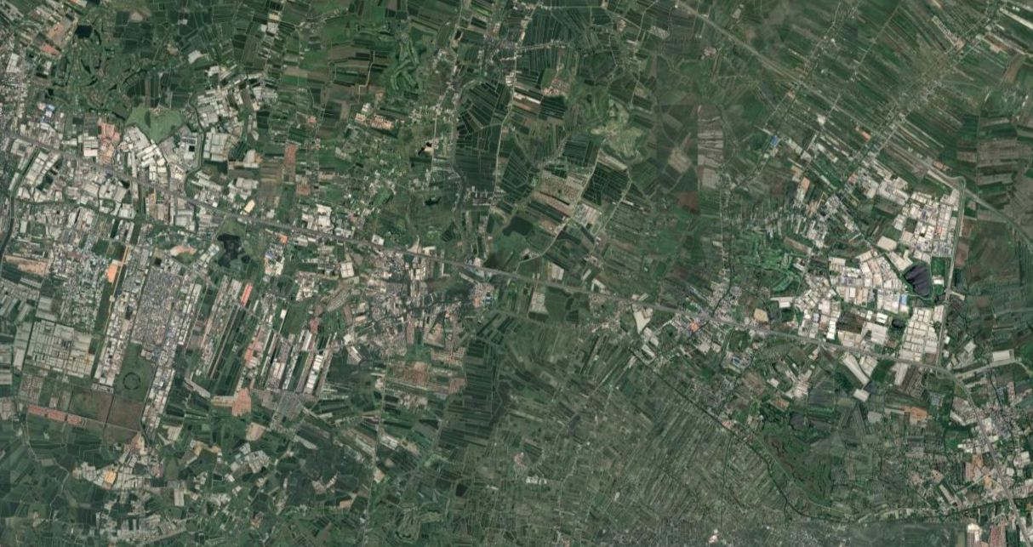











Land Located in the Bang Na Logistics Hotspot
Project Scale
Logistics Hotspots

Slide 19
Project Scale Overview
3

Slide 20
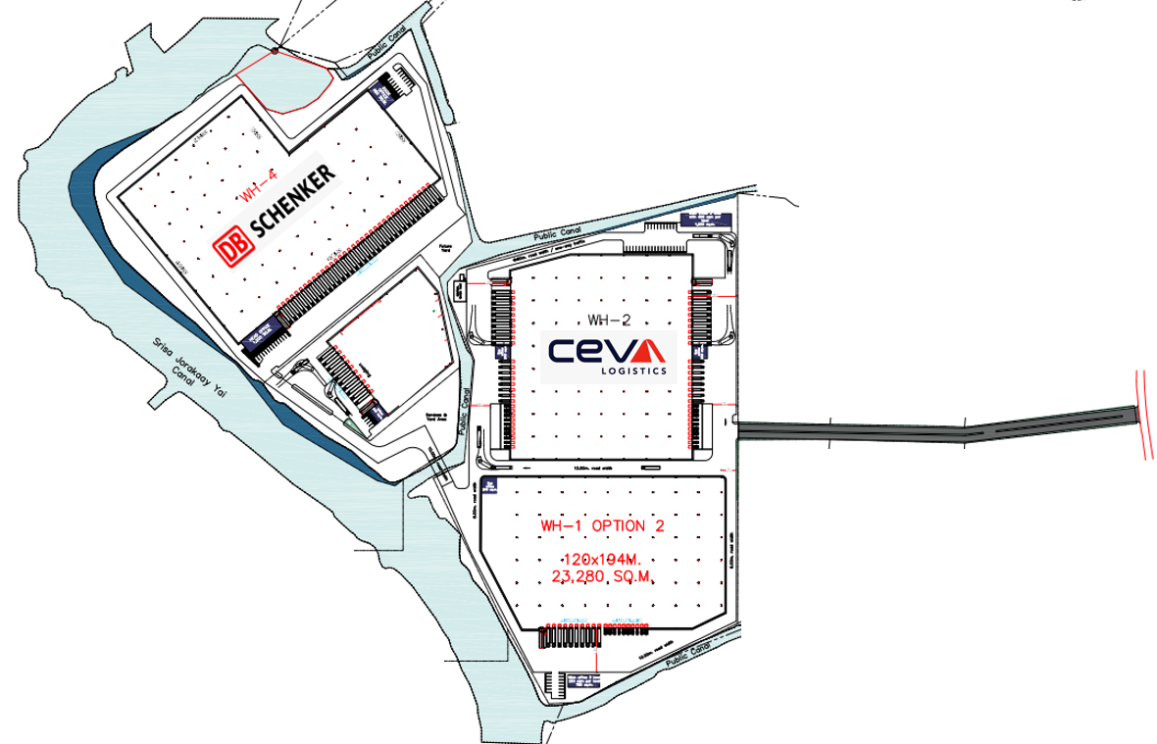
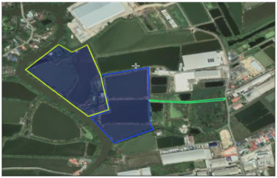
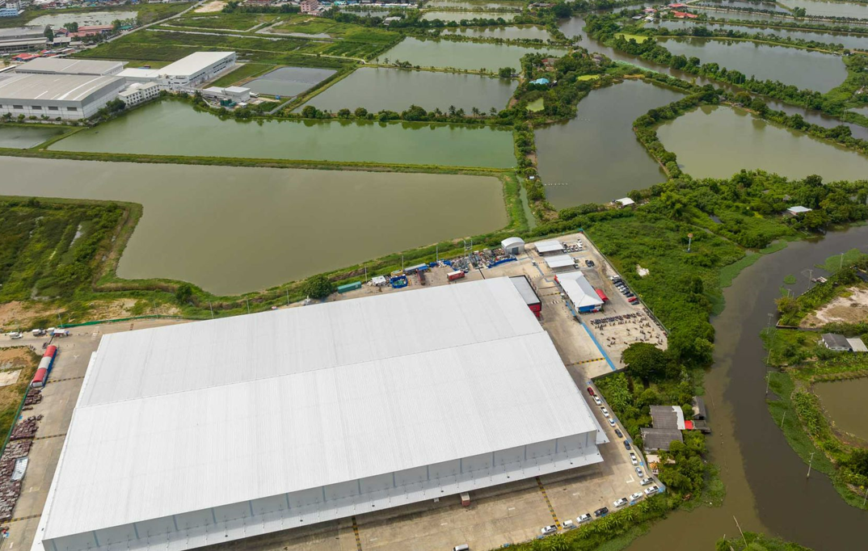
Project Scale - Overview
Key facts
Investment rationale
SECTOR Logistics
Deal Type Logistics
Planning Status & Land Tenure It is being sold as Freehold, purple zoned (correct zoning for logistics) greenfield site
Location Bang Na Trad
Scheme Warehouse 1: 22,244 sqm Warehouse 2: 24,714 sqm Warehouse 3: 6,730 sqm Warehouse 4: 29,980 sqm
Investment Metrics* Land cost: THB568m Development cost: THB1,340m Loan to Cost/Interest rate: 65%/4.87% (fixed) Net Operating Income (annual): THB165m Construction Period: 14 months Total Hold: 18 months Development Margin: 18% Estimated Exit Cap Rate: 6.50% Sale Type: Asset sold onshore Triple-Net Levered IRR: c 30%
logistics
The asset offers secure diverse cashflows across at least 2 major tenants who make up 65% of income which is secured for 10 years
Strategic significant land holding in the Bangkok area - 50km from central Bangkok
An exposure to 2 of the world’s top ten 3PLs. Both of which are looking at their sites to be multi-user and therefore easier to plan for longevity with multiple customers within their operations
Strong established trade logistics area
The asset will be best in class, will be future-proofed by strong ESG credentials and open additional opportunities for logistics investment in the immediate vicinity
C. 85k sq (Gross)
xxx
xxx
*These returns are indicative based on today’s cashflows & Levered post tax, post fee & pre promote. These returns are not guaranteed

Slide 21
Potential Initial Land Pipeline
4

Slide 22
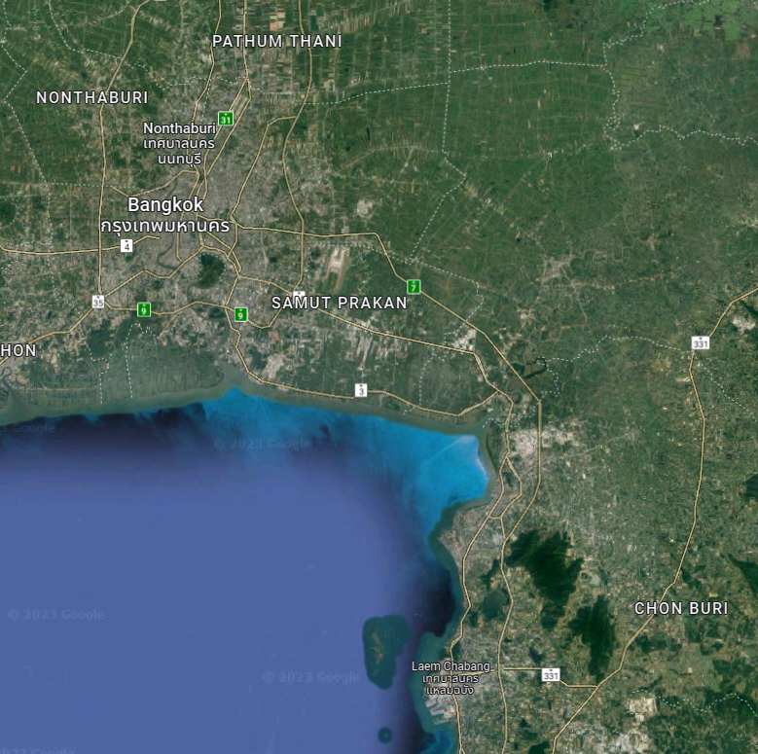
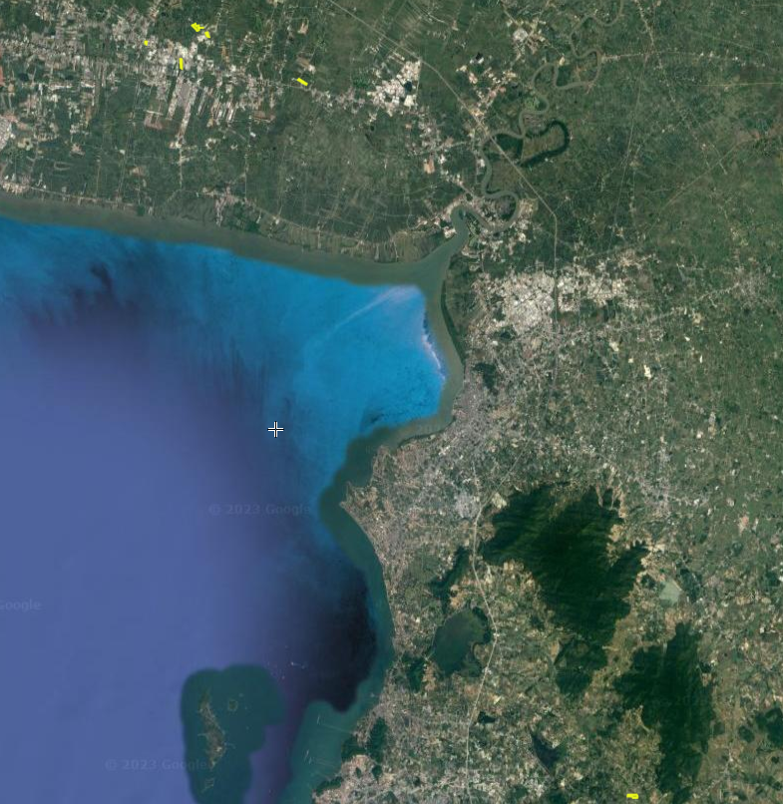
Location of Potential Zoned Land Plot
Source(s): Google Maps Aug2023 & Scribble Maps Aug 2023

Slide 23
Potential Initial Land Pipeline
Land Plot | Land Area (rai) | Land Area (sqm) | Location | Zone Color | Land Tenure | Estimated Gross Floor Area | sqm No. of buildings | Estimated Equity (USDm) | Estimated Gross Development Cost (USDm) | Estimated Land Acquisition
Plot 1 | 90 rai | 144,000 sqm | Bang Na/Samut Prakarn | Purple | Freehold | 85,000 sqm | 4 | $ 23.6 | $ 59.2 | Q4 2023
Plot 2 | 47 rai | 75,200 sqm | Bang Na/Samut Prakarn | Purple | Leasehold 30 + 15 years | 47,000 sqm | 2 | $ 11.3 | $ 28.3 | Q4 2023
Plot 3 | 16 rai | 25,600 sqm | Bang Na/Samut Prakarn | Purple | Leasehold 30 years | 16,000 sqm | 1 | $ 3.8 | $ 9.6 | Q1 2024
Plot 4 | 50 rai | 80,000 sqm | Bang Na/Samut Prakarn | Orange | Leasehold 30 years | 50,000 sqm | 2 | $ 11.4 | $ 28.5 | Q1 2024
Plot 5 | 31 rai | 50,000 sqm | Bang Na/Samut Prakarn | Purple | Freehold | 31,000 sqm | 2 | $ 9.4 | $ 23.7 | Q2 2024
Plot 6 | 81 rai | 129,000 sqm | Laem Chabang | Purple | Freehold | 78,000 sqm | 4 | $ 19.4 | $ 48.6 | Q2 2024
Total | 315 rai | 503,600 sqm |  |  |  | 307,000 sqm | 20 | $78.9 | $197.9
FX:THB/USD 1/35
Note (s): For Indicative purposes only; there is no guarantee that any particular investment or specific deal terms will be achieved or any return or distribution will be reailsed

Slide 24
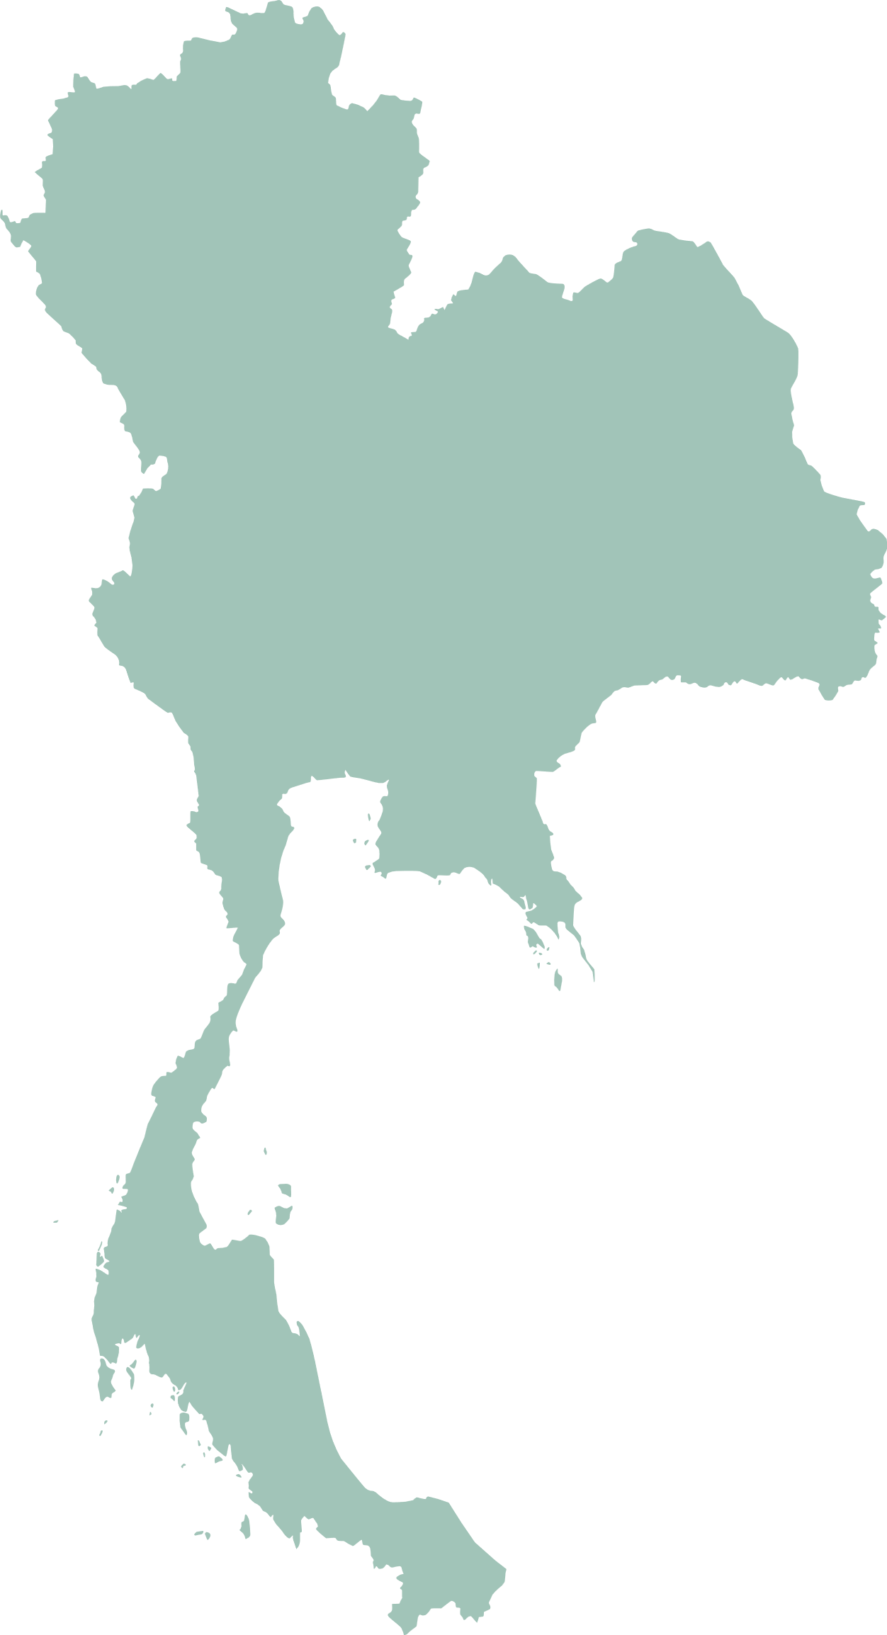
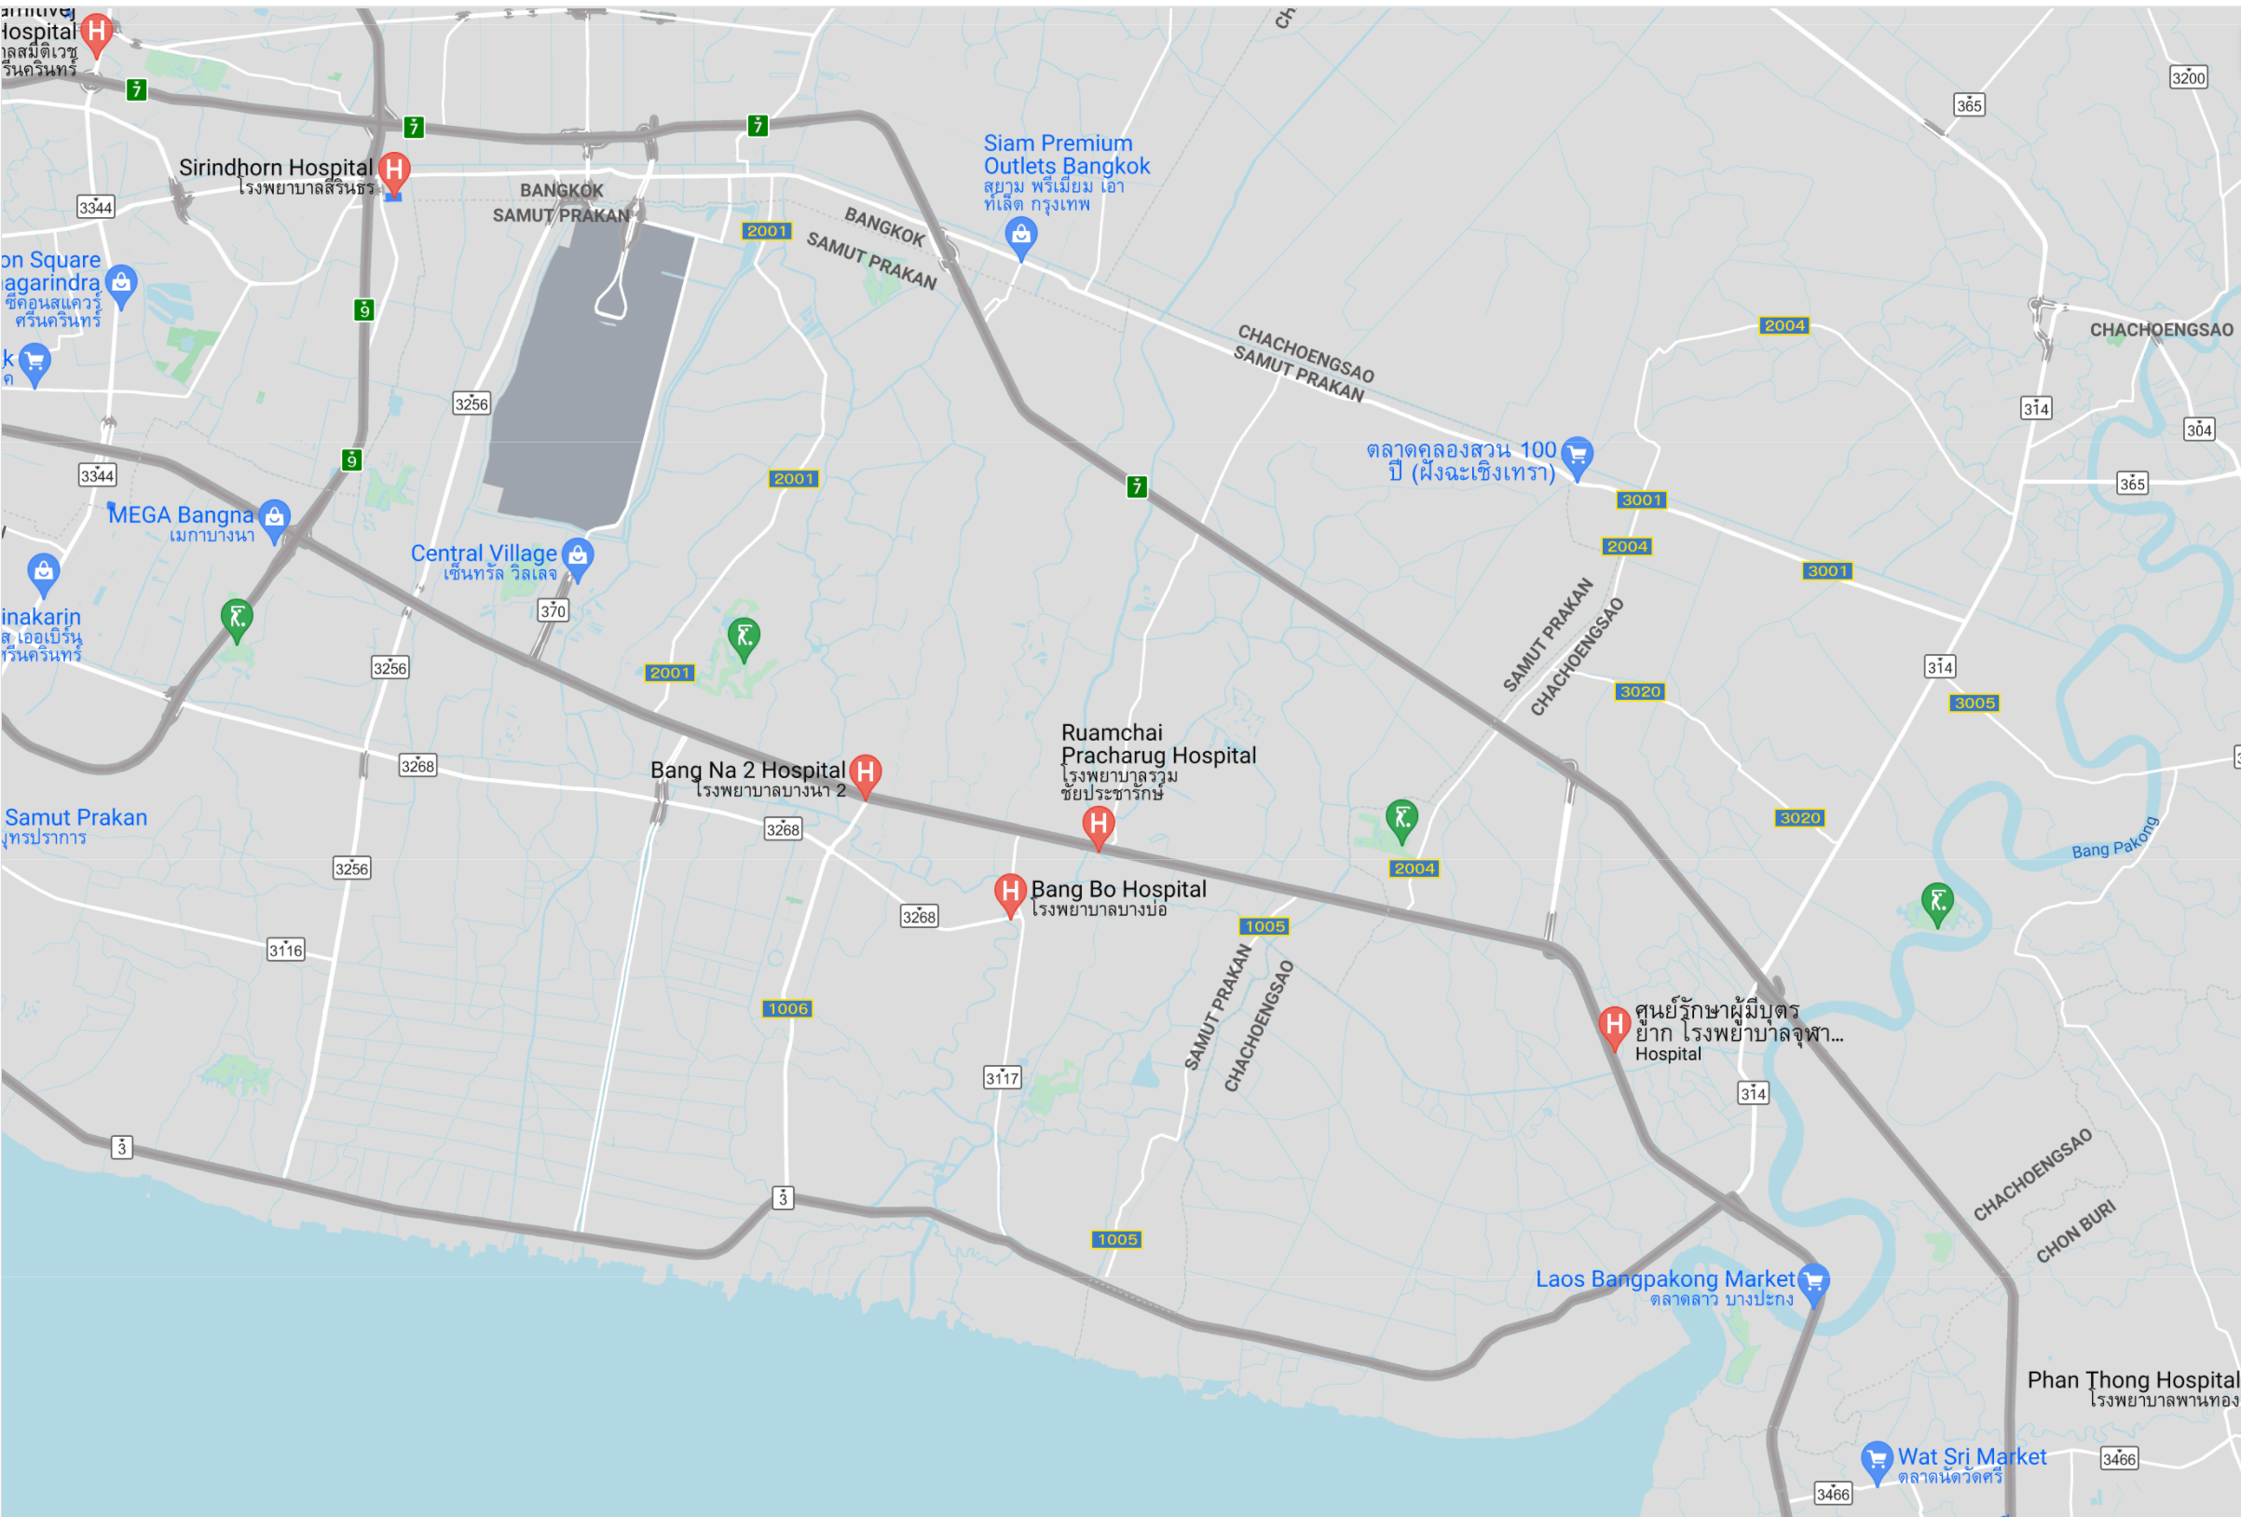


Infrastructure into Central Bangkok from Bang Na
Proposed New Road
Bang Na Trad
Bangkok Chon Buri Toll Road
Long Term Proposed Road
2001 Road
Plot 1
Plot 3
Plot 5
Plot 4
Plot 2
Location of potential land plot

Slide 25
Investment Strategy
5

Slide 26









Investment Strategy
Up to $120m
Target equity ticket size
Higher Quality
Market segment
Built-to-suit
On entitled land
Refurbish / Value-add
Select assets
Entry
Value Creation
Exit
Deal Sourcing |  | In-House Development Expertise |  | Potential Buyers
Avoid competing head-on with megafunds for large logistics assets / portfolio deals Focus on small-to-midsized deals Source off-market, undervalued logistics land parcels/assets via Savills IM’s exclusive network with logistics partners |  | Spearheaded by Nicholas Kinsey who has 17 years of logistics experience across DHL, CEVA Logistics, XAct Solutions and Goodman ESG pathway Asset level strategies to meet sustainability obligations |  | REITs Core/core+ private real estate funds Institutional investors Individual investors SIM Open-Ended Vehicles
Entry Underwriting |  | Vertically-Integrated Asset Management |  | Exit Underwriting
Focus on underlying land value as the main entry valuation benchmark Look at land bank opportunities to aid in quick expansion & maximize value |  | Deep relationships with creditworthy partners/tenants such as DHL and CEVA |  | Thailand: 15-17% net IRR*
✔
 |  | Holding Period
 |  | Thailand: 36-48 months (option to hold)
* For indicative purposes only; there is no guarantee that any particular return will be realized

Slide 27





Investment Strategy
Land and Planning
SIM Development Process
Land in Thailand is available with a mix of Leasehold & Freehold
Preference is for investment into Freehold land
Focus land with purple zoning – suitable for logistics & manufacturing
Other opportunities for leasehold land on a case-by-case basis
1.
LAND ACQUISITION
Various sources both market & off market
2.
PLANNING & DESIGN
Layout test fit by experienced local designer or shortlisted & reputable design & build contractor
AUTHORITY SUBMISSION
Detailed authority submission flow chart prepared during comprehensive Due Diligence. Thailand has a defined approval process.
Structuring*
3.
PROCUREMENT
Competitive tendering process for General Contractor selection for controlling budget with International Federation of Consulting Engineers (FIDIC) Design + Lump Sum contract model
Independent Quantity Surveyor involvement if required
5.
PROJECT HANDOVER
Adequate training and testing and commission as outlined in a comprehensive design brief. Defects liability period (DLP) thoroughly maned through the 12 months period post construction. Detailed reporting and sign off at each stage of handover and post DLP.
SIM
JV Partner
4.
CONSTRUCTION
Experienced team of contractors with relevant experience and strong track record, Project Mangers & specialist consultants such as floor design review
Singapore
Thailand
JV Partner
SIM
SPV
Bank
Project
* The structuring chart is for illustrative purposes only.

Slide 28
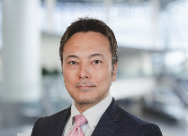
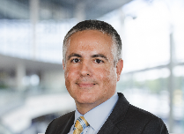
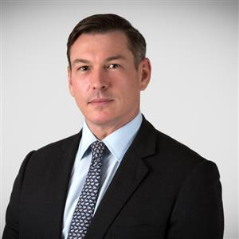

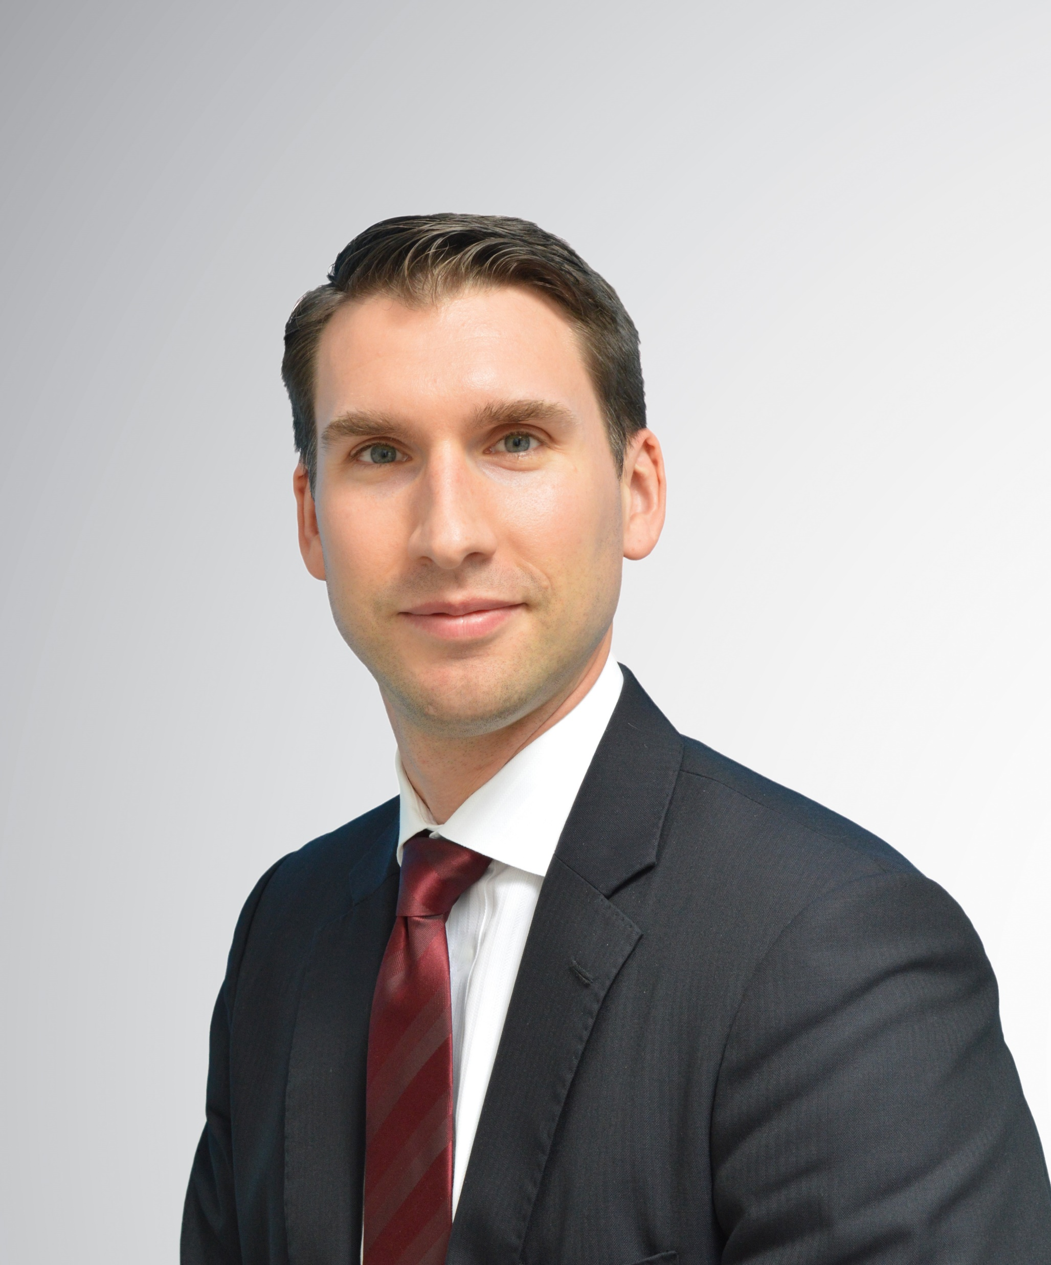
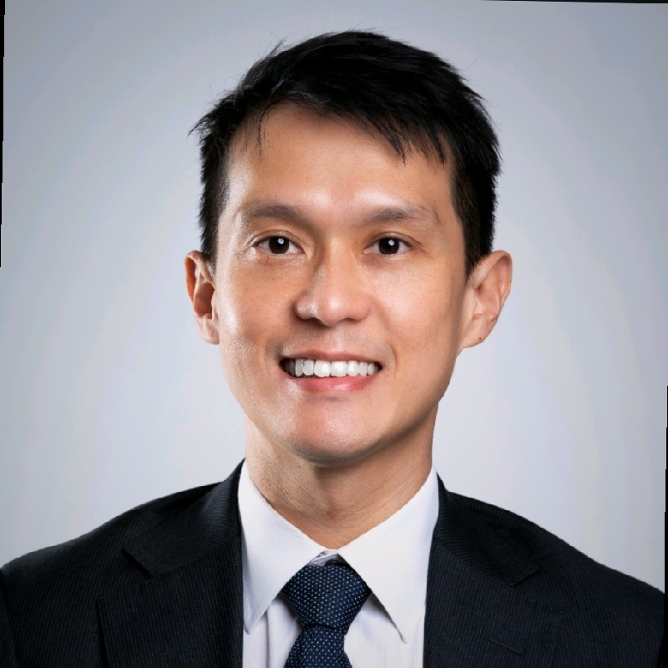


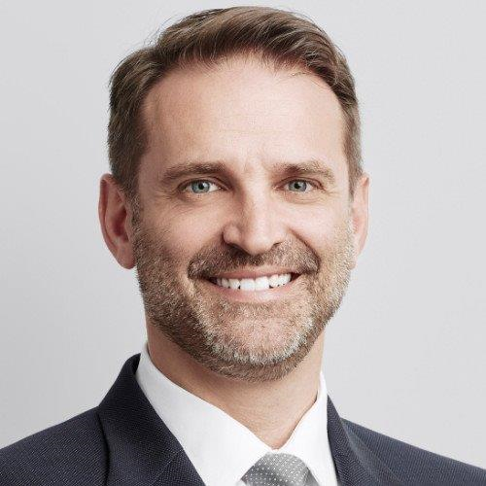
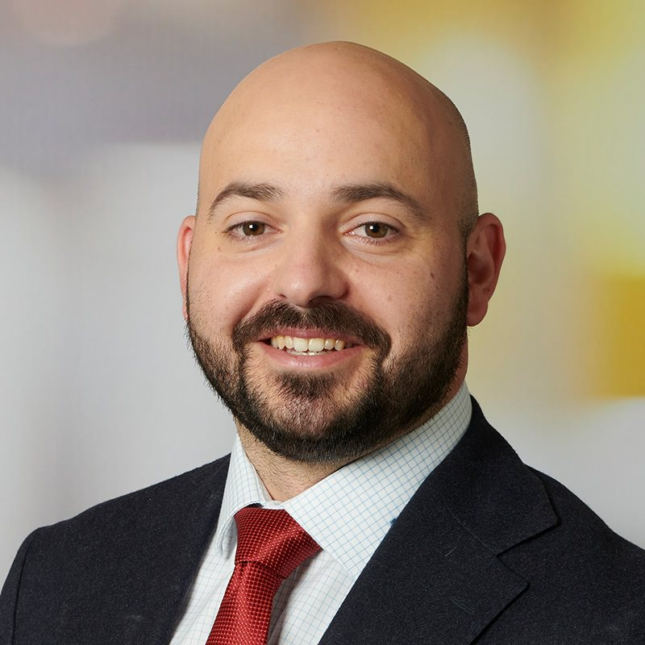
Team - Leverage Savills IM Regional Footprint
Japan
Global Support
Platform Sponsorship
>20 years working together
Michael Flynn
GEC Member - Co-Head, Client Capital
26 years experience
Ex Goldman Sachs IB and PIA, Credit Suisse First Boston
Thailand
Nicholas Kinsey
Head of Logistics APAC
17 years experience
Ex DHL, Xact/TMX, CEVA, Goodman
Tadaaki Kurozumi
Managing Director, Co-Head of Japan
27 years experience
Ex Merrill Lynch, co-founder Merchant Capital
Tom Silecchia
Managing Director, Co-Head of Japan
24 years experience in Japan
Ex Merrill Lynch, co-founder Merchant Capital
Product Support (based in Europe)
Legal
Will Johnson
Director, Investments - Japan
15 years experience (14 in Japan)
Research & chartered surveyor background
Compliance
Risk
Tax
Singapore
Finance
Shao Wei Toh
Head of Research & Strategy Asia
13 years experience
Ex UBS, CapitaLand, UOL, UOB
ESG
Australia
Fan Boxin
Investor Relation/Product Development/Business Development
10 years experience
Ex Mizuho, China Construction Bank,
EY
Greg Lapham
Fund Manager and Head of Australia
31 years experience
Ex BlackRock CIO, lived in HK, Tokyo
Guy Sainsbury
Investment Director
26 years experience
Ex Lendlease, lived/studied in Tokyo
Anthony Lupis
Investment Manager
14 years experience
Ex Centuria, trained valuer

Slide 29
Thailand Team*
Country Head
Analyst
Construction
Leasing & Business Development
Admin & Finance
APAC Head
Potential Local External Experts Identified:
Expertise | Company | Company | Company | Commentary
Legal | Mahanakorn Partners Group | Bluementhal, Richter & Sumet | Prompt Legal | A diverse range of local and international law firms are located within Thailand. Sufficient expertise is available with both local and international clients
Tax | KPMG | EY | BDO | Intenational tax experts with global relationships have in country office subject matter experts able to assist
Construction | Christiani & Nielsen | Thai Takenaka | Italian Thai | Both local and international construction groups openly compete, milestone payment program SIM will only work with groups with sufficient experience and strong balance sheets.
Project Management | Meinhardt | Savills (regional team) | Archetype | Availability of both local and internationally groups Diverse level of expertise across multiple asset classes
Due Diligence | Meinhardt | Archetype |  | Well known reputable group with global platform & deep local expertise In house expertise to undertake Due Diligence
Leasing | Savills | Knight Frank | JLL | All international real estate agent groups are represented in Thailand
Property Management | Savills | JLL | Knight Frank | Savills locally have a strong property management department Competitiveness can be bench marked with like groups
Subject Matter Experts | CoGri Asia | Meinhardt |  | Ensuring high-quality construction subject matter experts will be engaged for concrete and other disciplines when/where required
*Note(s): The above organizational chart is an indicative representation of the eventual logistics team when fully built out. Currently, the team consists of APAC & Country Head (double hat), based in Thailand supported by an Analyst based in Singapore

Slide 30











ESG will be at the heart of our logistics strategy
ESG Initiatives – Savills IM APAC Logistics Program
Environmentally friendly construction process
Tenant wellbeing
LED lightings
Solar panels
Rainwater tanks
Savills IM Focus Areas & Target
Climate Change Resilience
Social Value
Climate Change Resilience
Ground Environmental Factors
Health & Wellbeing
Carbon Impacts
Carbon Impacts
Economic
50% energy intensity reduction of our AUM by 2030
Reach Net Zero by 2040
Generate renewable energy and invest in offsetting solutions
Comprehensive learning & development plan / inclusive working practices
Aspiration that all AUM promotes health and wellbeing outcomes + community cohesion, social mobility and inclusion.
Increase biodiversity and purposeful green space by 50% by 2030 across our AUM and by 100% by 2040
Halve water intensity and waste by 2030
Achieve 100% recycling rate by 2030
Climate Action
People
Nature

Slide 31
Resilience. Responsibility. Results.
Thank you

